Slide 1

Large scale analysis and modeling group
http://mgroup.ntua.gr

Slide 2
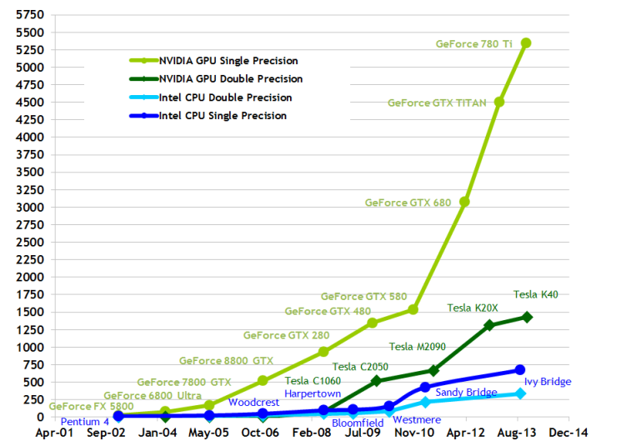
CPU vs GPU
Flops

Slide 3
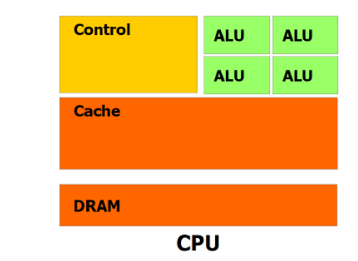
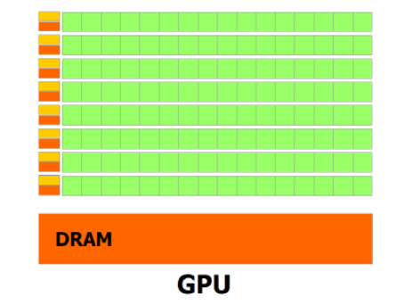
CPU vs GPU
GPUs have massive computational power (many many more ALU)
CPUs have more advanced control units => better at path prediction
CPU memory can be easily increased. GPU cannot.

Slide 4
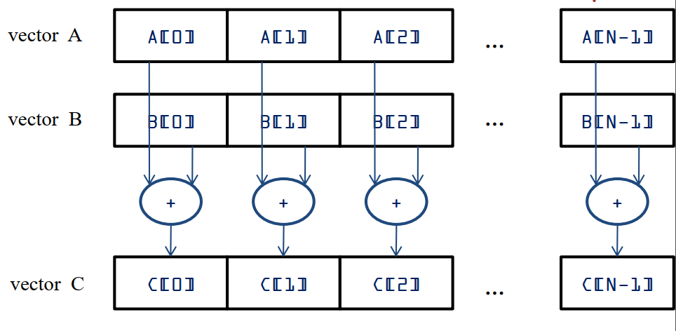
Vector addition in SIMD

Slide 5
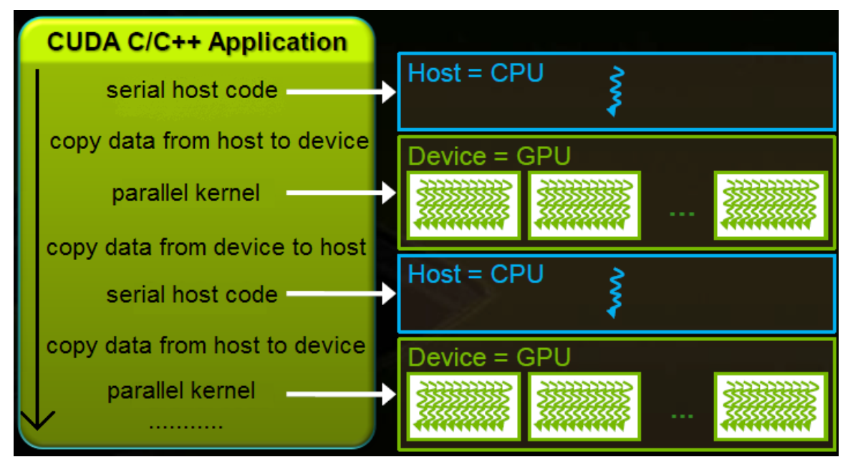
General Purpose GPU Programming
CUDA
Only NVidia
OpenCL
OpenAAC
C++ AMP
ILGPU
Wrapper for .NET

Slide 6
Data locality
Memory must be copied from CPU to GPU before computations (kernels)
The results must be copied from GPU to CPU after computations.
This can be slow and can should be optimized
Try to avoid copying large data if not needed.
Copy a lot of data together instead of smaller more frequent copies.
Use streams

Slide 7
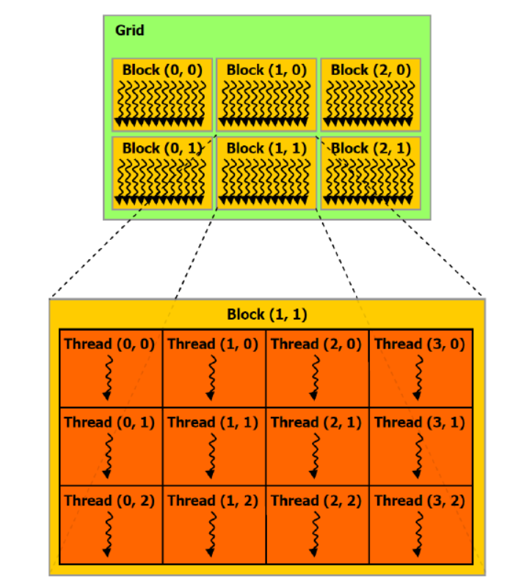
Thread Grouping
Blocks are called “groups” in ILGPU
Each thread has a local index in its block and a global index in the whole grid.
Each index can be 1D, 2D or 3D
There is a limit to the number of threads per group and total threads.

Slide 8
Thread Grouping
Not all threads of a group are executed simultaneously. The GPU schedules them depending on available resources.
Warps are groups of 32 threads (16 on older GPUs) that are executed simultaneously.
A lot of data accesses and operations for the threads of the same warp can be optimized
Limit the number of control divergence in threads of the same warp.

Slide 9
Map operation in SIMD
Vector addition is a “map” operation.
No communication between threads is needed
Memory accesses are coalesced

Slide 10
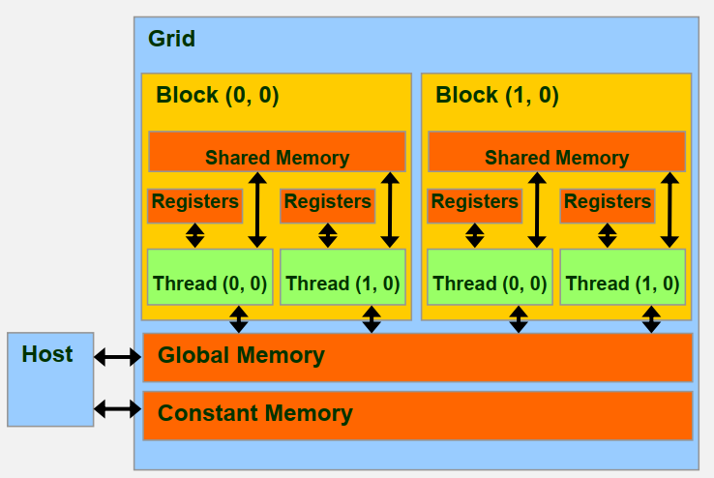
GPU memory model
Registers hold local variables of kernels
Shared memory of each block can be used to communicate between threads of the block.
Constant memory is very efficient for global constants. Threads of the same warp will only access it once.
Global memory is the slowest and largest.

Slide 11
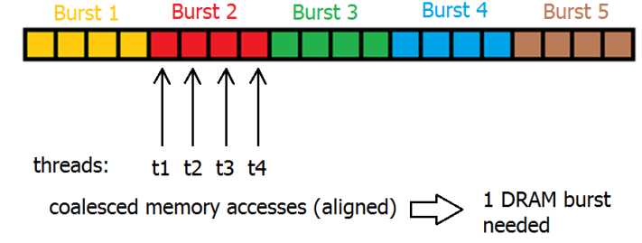
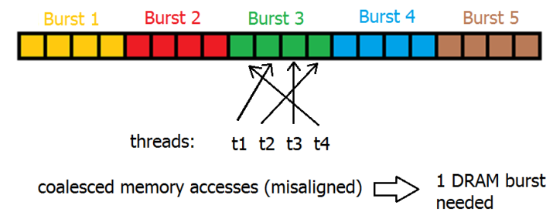
Global memory coalescing
Global memory accesses are done in burst mode: many consecutive data is accessed per request.
If threads of the same warp (which have consecutive thread indices) request nearby memory, only 1 request is needed.
This is coalesced memory access and is a primary goal.

Slide 12
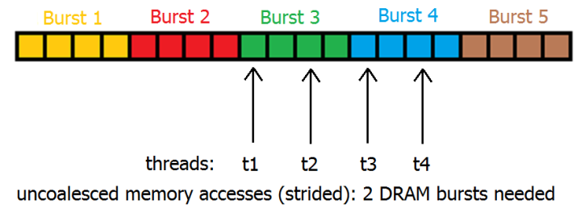
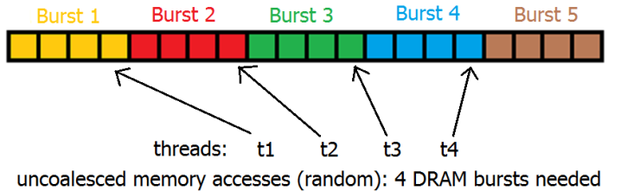
Global memory coalescing
Otherwise uncoalesced memory accesses can significantly reduce performance.

Slide 13
Shared memory
Shared memory of each block can be used to communicate between threads of the block.
Copy data from global memory to shared memory of each block once.
Then threads of that block can read/write the same shared memory multiple times, much faster.
Finally copy back shared memory to global memory.

Slide 14
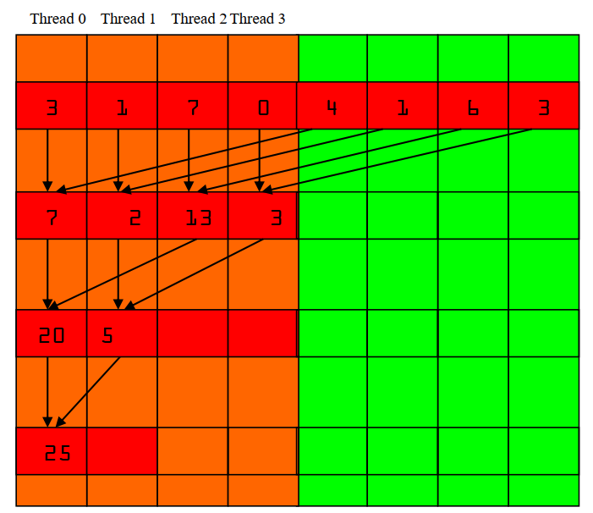
Reduction operation (sum)
O(log2(n)) steps
At each step, half the previous threads are active.
Reduction steps happen in shared memory
First copy from global
At the end there will be 1 value per group. Copy these to an array in global memory.
Repeat reduction kernel to decrease the array or reduce sequentially in host.

Slide 15
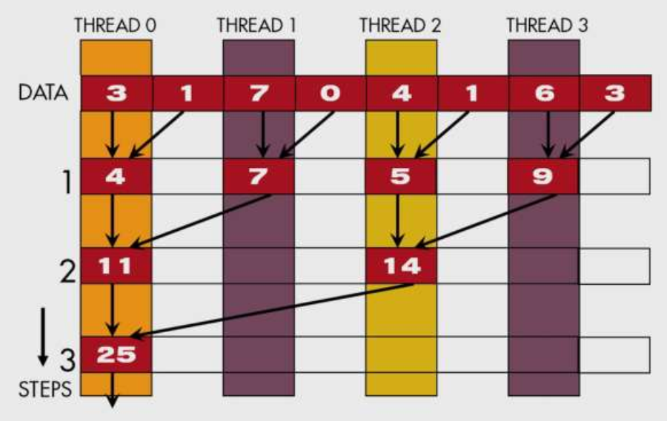
Reduction with warp divergence
Same strategy as before
The active threads are further and further away.
Therefore some threads of the same warp are active and some inactive => divergence.
This version is less efficient due to warp divergence.

Slide 16
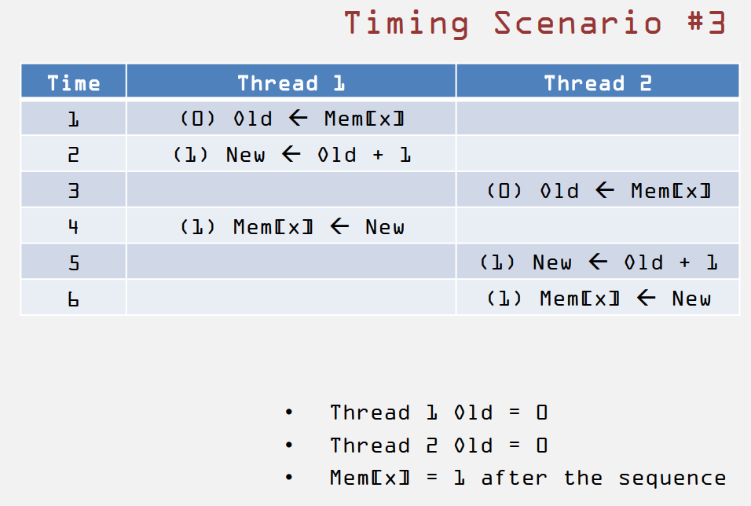
Race conditions
Two threads try to increment a value
3 basic commands per thread
No way to predict scheduling
Hard to find bugs
Problem for global and shared memory

Slide 17
Atomic Operations
A thread tries “atomic add” at a memory address:
Locks the memory address for all other threads
Reads the content of memory address
Adds the read value with another
Writes the result back to that memory address
Unlocks memory address for other threads.
Various atomic operations other than add.
This will reduce performance dramatically.
Avoid atomics if not necessary
Use atomics for memory addresses that are not accesses by many threads

Slide 18
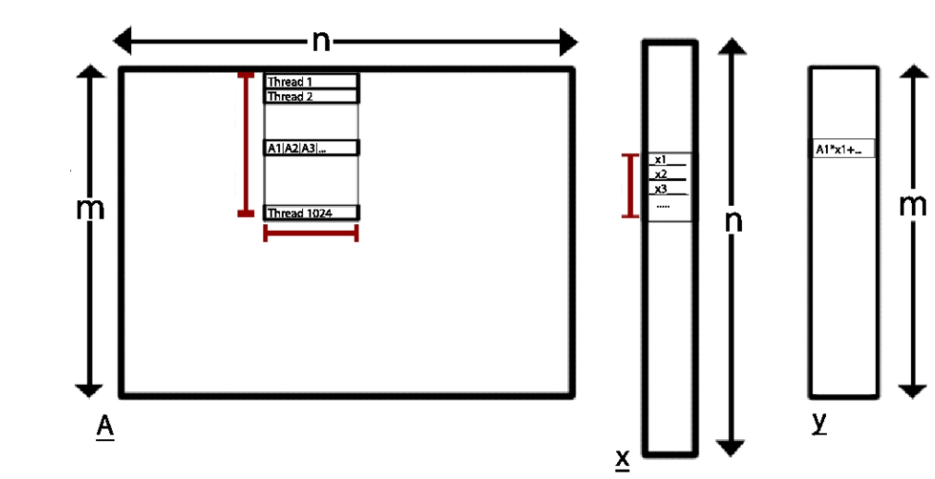
Matrix-vector multiplication
Group.IdxX
Multiple groups for x axis with a specified width
Multiple groups for y axis with a specified height
Groups are 1D and contain “groupHeight” threads.
groupHeight
Group.IdxY
groupWidth
groupWidth

Slide 19
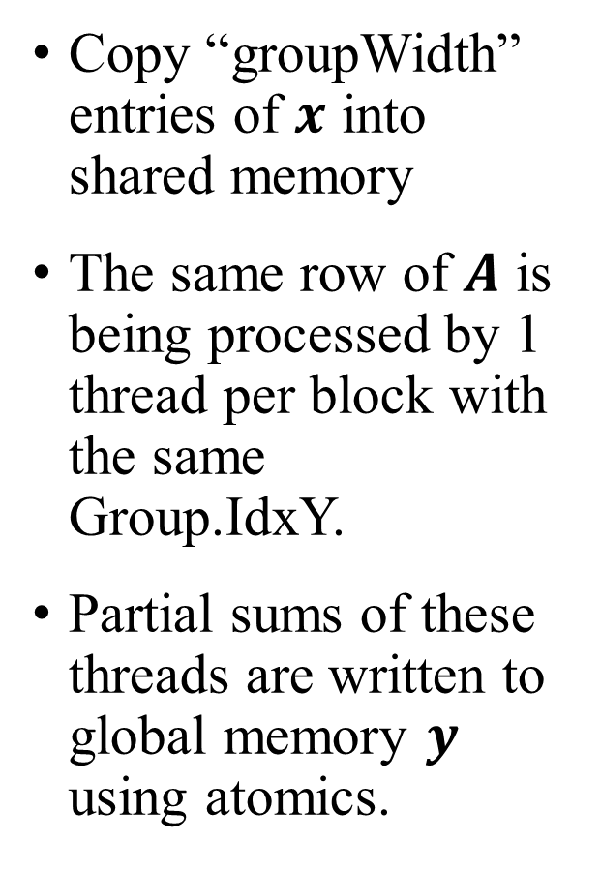
Matrix-vector multiplication
Group.IdxX
Copy “groupWidth” entries of $x$ into shared memory
The same row of $A$ is being processed by 1 thread per block with the same Group.IdxY.
Partial sums of these threads are written to global memory $y$ using atomics.
groupHeight
Group.IdxY
groupWidth
groupWidth

